Slide 1
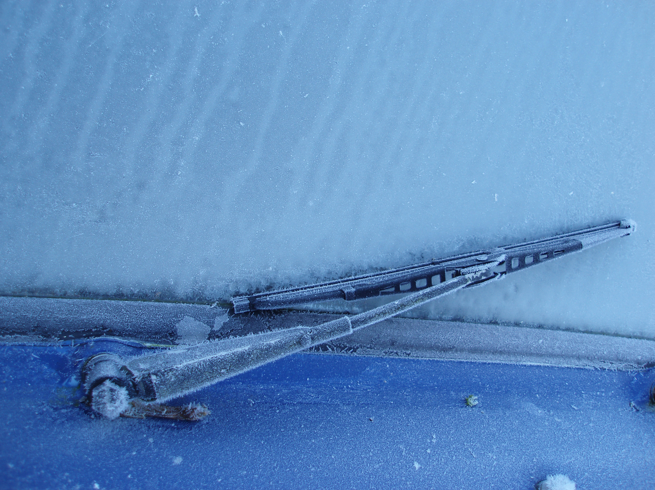

IRUNGATTUKOTTAI,SRIPERUMBUDUR,CHENNAI-602117.
(AFFLIATED TO ANNA UNIVERSITY AND APPROVED BY AICTE, ACCREDITED NAAC AND NBA)
Automatic Rain Sensing Car Wiper Using Arduino
SUPERVISOR
Dr.S.LEKASHRI
Assistant Professor
ECE
Kings Engineering College
TEAM KINGS WARRIORS
1.ARAVIND.M
2.HARISH.S
3.MAGESH.G
3rd YEAR ECE
Kings Engineering College

Slide 2

CONTENTS
Introduction.
Motivation.
Objectives.
Related Study.
Hardware & Software Requirements.
Project Background.
Pin Diagram.
Circuit Diagram.
Program.
Affecting Factors.
Advantages & Disadvantages.

Slide 3
INTRODUCTION
This project is designed to build a car wiper that automatically detects the rainfall intensity and regulates the frequency of wiper operation.
It is built, using Arduino UNO board.
A rain sensing module is used for measuring the intensity of rainfall.
A servo motor is used for controlling the wiper movements.
An LCD module is also attached to the controller for displaying the rainfall intensity.
By measuring the amount of rainfall , controller will adjust the speed of servo motor .
Servo is controlled by generating PWM signal at its signal line.

Slide 4
MOTIVATION
Every year more than 1.3 million people die world wide because of car accidents according to World Health Organization. People end up dying for small mistakes.
Today`s car wipers need human intervention to start the wiper. This causes inconvenience to the driver during rainfall.
Driver neither concentrate on driving nor adjustment of the wiper. This leads to accidents.
To reduce these accidents we purpose an AUTOMATIC CAR WIPER SYSTEM that automatically switching on the wiper on detecting rain and stops when rain stops.

Slide 5
OBJECTIVES
Measuring the amount of rainfall.
Displaying the intensity of rainfall in an LCD module.
Controlling the servo motor speed according to the output from the sensor module.

Slide 6
RELATED STUDY
Every year, roughly 1.3 million people die in car accidents worldwide – an average of 3,287 deaths per day.
A study based on data from the National Highway Traffic Safety Administration shows that most weather – related crashes happen on wet pavement (73%) and when it rains (46%).

Slide 7
CAUSES OF CAR ACCIDENTS
Speeding
(34.4%)

Slide 8
HARDWARE & SOFTWARE REQUIREDMENTS
Arduino/Uno. (ATMEGA328p)
Servo motor. (MG90S)
16x02 Lcd Display. (JHD162A)
Rain drop Sensor. (YL83)
Jumper wires.
Arduino IDE 2.0 RC Software. (Ver.2.0.0-rc5)
9VPower Supply.

Slide 9
PROJECT BACKGROUND
To design this system, we use a rain sensor, Arduino, Servo motor and LCD module.
The Arduino Uno is an open-source microcontroller board based on the Microchip ATMEGA328P Microcontroller.
A rain drop sensor is one kind of switching device which is used to detect the rainfall.
A servomotor a simple electric motor, controlled with the help of servomechanism.
Whenever the rain falls, The rain sensor detects the intensity of the rainfall and sends information to Arduino.
Based on intensity of rainfall and controller will adjust the speed of servomotor automatically.
The LCD module displays the intensity of the rainfall.
The car wiper stops automatically when the rain stops.

Slide 10
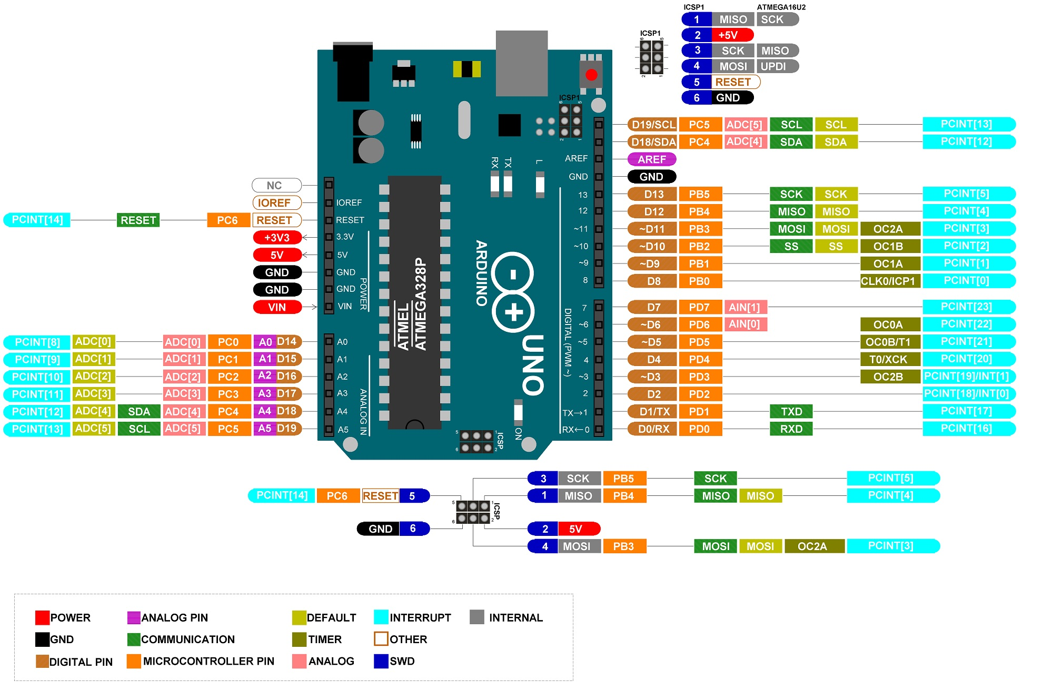
ARDUINO PIN DIAGRAM

Slide 11
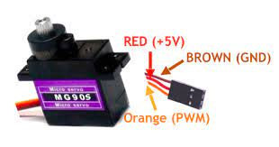
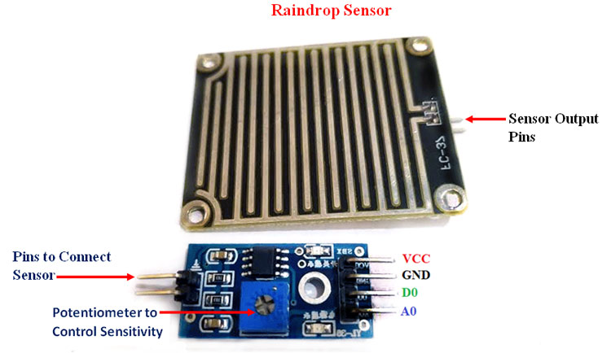
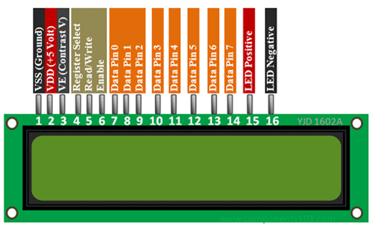
PIN DIAGRAMS FOR REQUIRED HARDWARES
SERVO MOTOR
16X02 LCD display

Slide 12
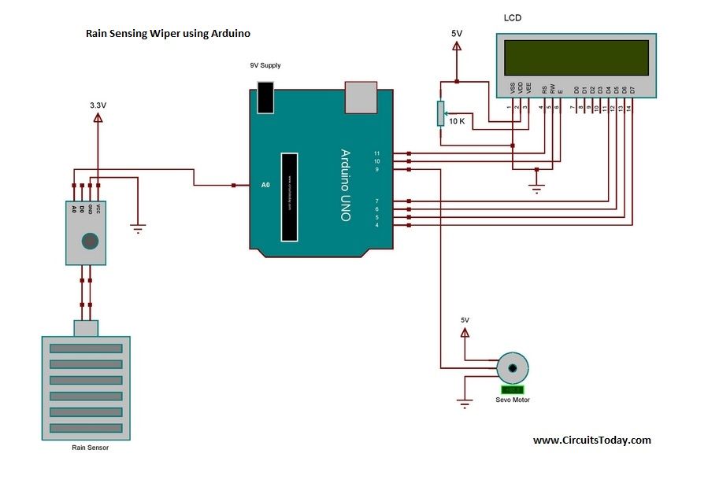
CIRCUIT DIAGRAM

Slide 13
PROGRAM
#include <LiquidCrystal.h>
#include <Servo.h> LiquidCrystal lcd(11,10,7,6,5,4);
Servo myservo; int pos = 0;
int sensorValue = 0; void setup()
{
Serial.begin(9600);
lcd.begin(16,2);
myservo.attach(9);
lcd.clear();
lcd.setCursor(0,0);
lcd.print("Intelligent Rain");
lcd.setCursor(0,1);
lcd.print("Sensing CarViper");
delay(3000);
lcd.clear();
lcd.setCursor(5,0);
lcd.print("Rainfall");
lcd.setCursor(0,1);
lcd.print("Intensity-");
}

Slide 14
void wipe(int Speed)
{ if(Speed>400)
{
Speed=5000;
lcd.print(" LOW ");
}
if(Speed>350&&Speed<=400)
{
Speed=3000;
lcd.print("MEDIUM");
}
if(Speed<=350)
{
Speed=500;
lcd.print(" HIGH ");
}
for (pos = 180; pos >= 0; pos--)
{
myservo.write(pos);
delay(3);
}
for (pos = 0; pos <= 180; pos++)
{
myservo.write(pos);
delay(3);
}
delay(Speed);
}

Slide 15
}
for (pos = 0; pos <= 180; pos++)
{
myservo.write(pos);
delay(3);
}
delay(Speed);
}
void loop()
{
lcd.setCursor(10,1);
sensorValue = analogRead(A0);
Serial.println(sensorValue);
if(sensorValue>600)
{
myservo.write(180);
lcd.print(" NIL ");
delay(1000);
}
if(sensorValue<=600)
{
lcd.setCursor(10,1);
wipe(sensorValue);
}
}

Slide 16
AFFECTING FACTORS
1.Comfort : To operate the wiper with response to changing rainfall and driving conditions, thus keeping the driver‘s windshield clear. 2. Installation : The system is easy to install. In the installation process we add one sensor system on the front glass. When sensor detect water droplet then wiper system is operating. If the installation is not done properly it may not work accurately as its designed purpose. 3. Failsafe Function : It is assured that the wiper operates at 6-second intervals when the drop detection function is disabled because the sensor is completely blocked by dust, snow, or other matter stuck to the sensor.

Slide 17
ADVANTAGES
It Consumes Less Power Of Operation
Operating Principle Is Very Easy.
Hands-free Calling.
Sensor Cost Is Low.
DISADVANTAGES
The Rain Sensor based System Function when Water Falls On The Sensor Directly.
The Cost Of Over All System increases As Additional Components are Needed Along With Rain Sensor.
In Order To Avoid False Direction Of Rain , it Requires Rain Sensors To Take Decision After Few Minutes.

Slide 18
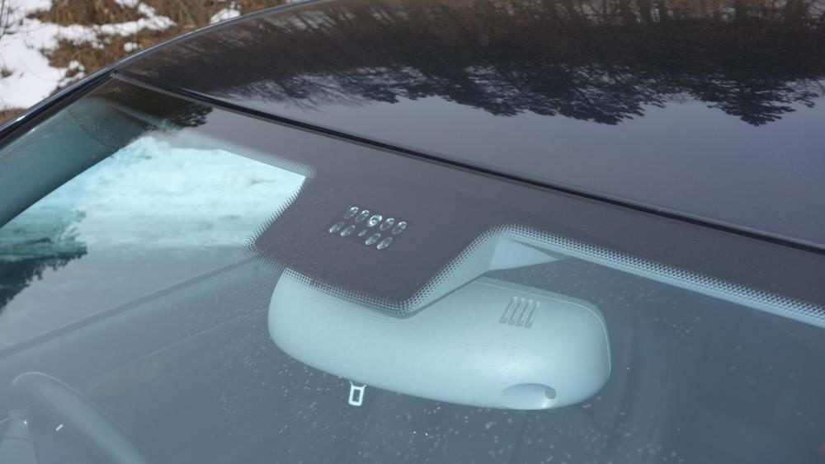
RAIN DROP SENSOR

Slide 19
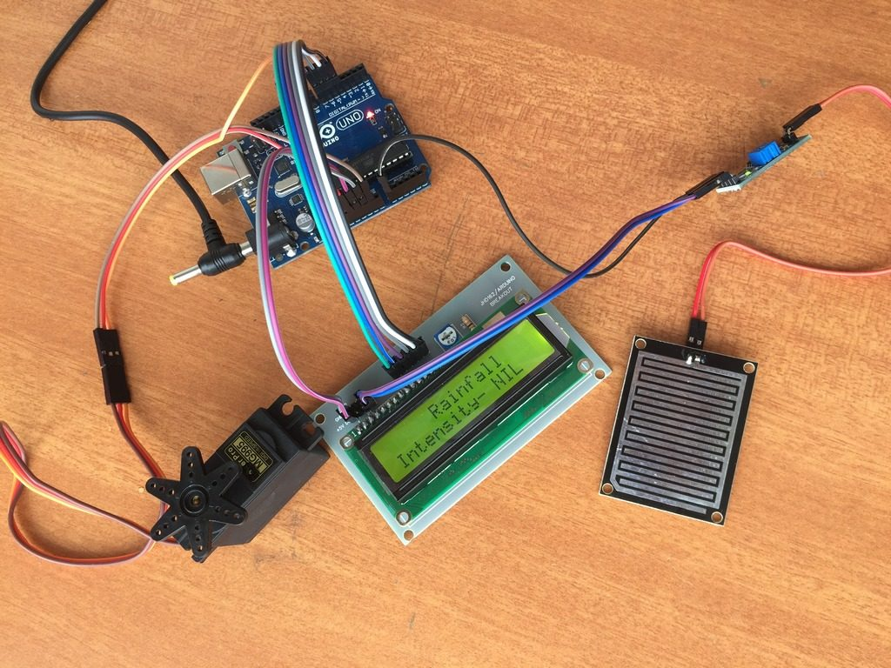

Slide 20

This Photo by Unknown Author is licensed under CC BY-SA

